Slide 1
FLIGHT PRICE PREDICTION PROJECT
Aim is to develop a new machine learning model to predict flight prices with respect to the current market conditions.

Slide 2
Business problem
Anyone who has booked a flight ticket knows how unexpectedly the prices vary. The cheapest available ticket on a given flight gets more and less expensive over time.
This usually happens as an attempt to maximize revenue based on –
1. Time of purchase patterns (making sure last-minute purchases are expensive)
2. Keeping the flight as full as they want it (raising prices on a flight which is filling up in order to reduce sales and hold back inventory for those expensive last-minute expensive purchases).
So we will need to build a model that can predict the price of the flight.

Slide 3
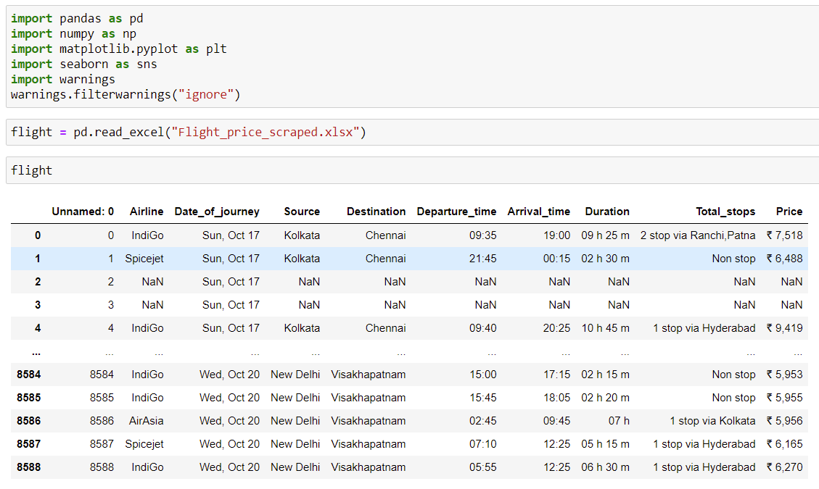
Understanding data
We will now import the scraped data and understand the data.
Price would be our target
column. We will need to
clean price and other
columns.

Slide 4
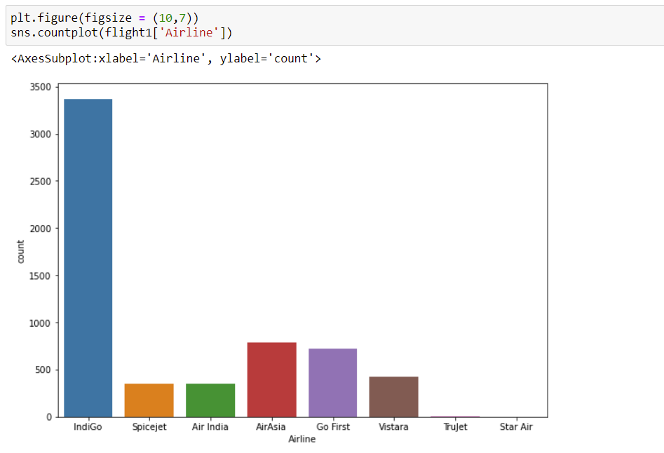
Indigo would be the most preferred Airline

Slide 5
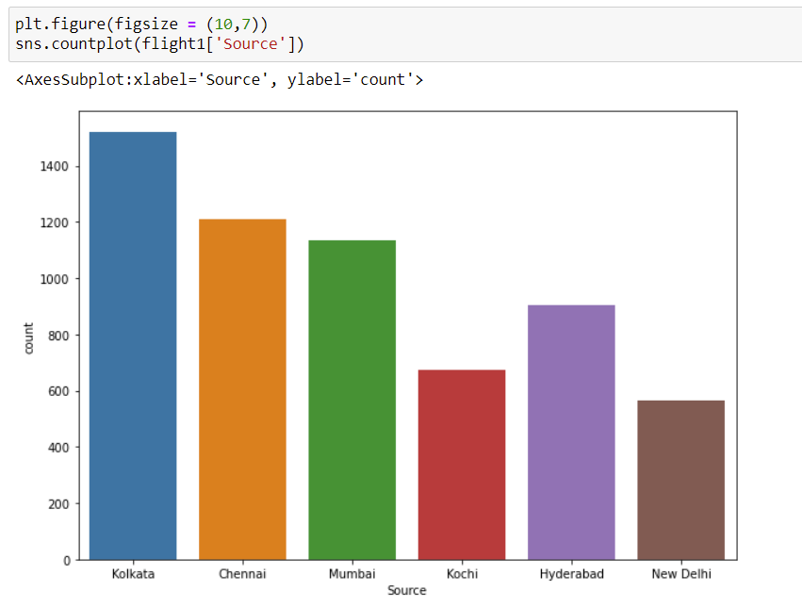
Majority of flights take off from Kolkatta and Chennai.

Slide 6
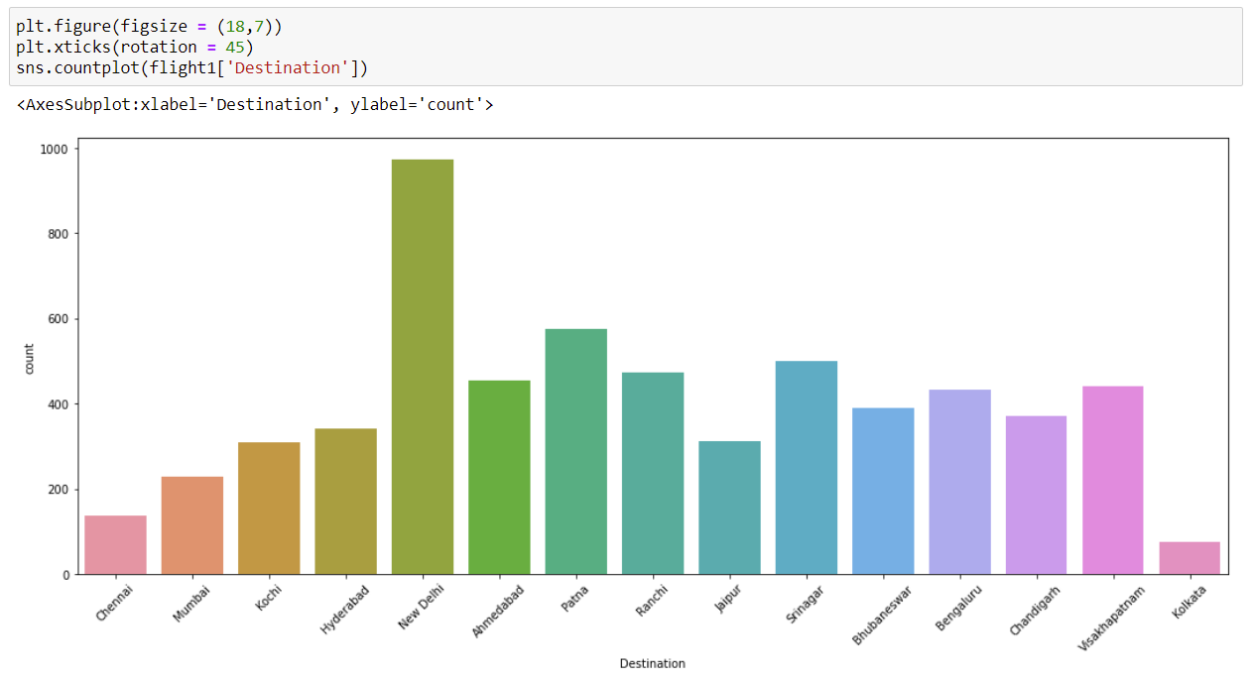
Maximum flights land in New Delhi and Patna

Slide 7
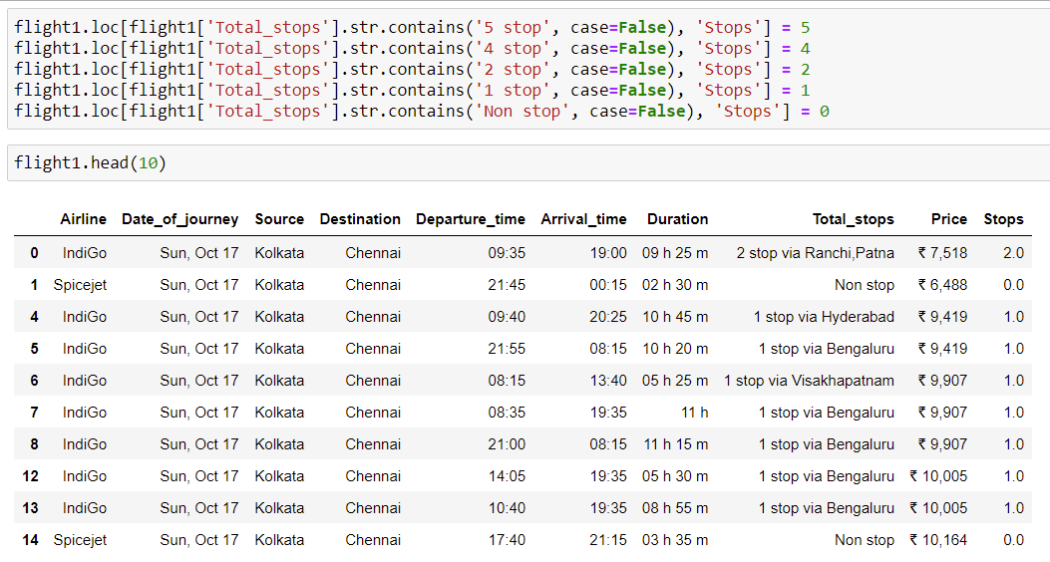
We have now cleaned Total_stops columns

Slide 8
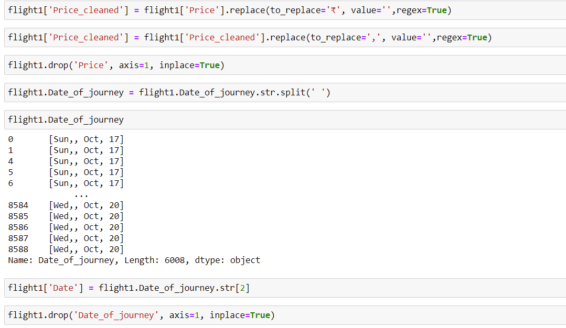

Slide 9
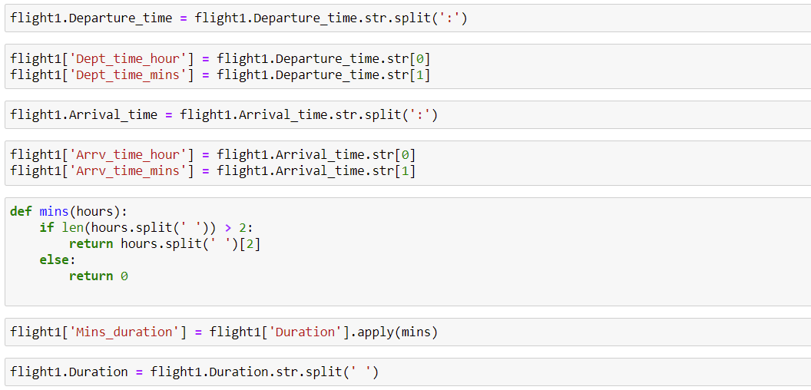
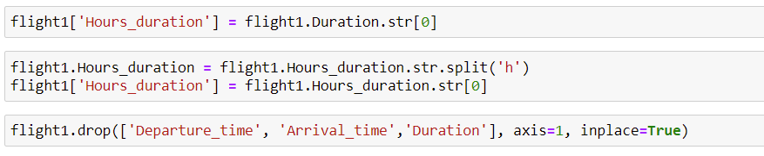

Slide 10
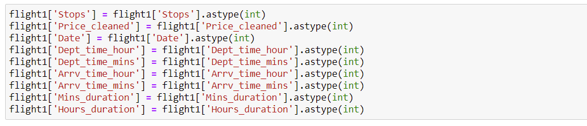
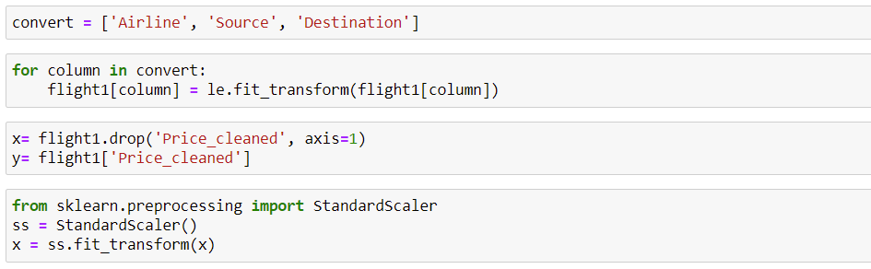
we have converted the columns into integer data type.

Slide 11
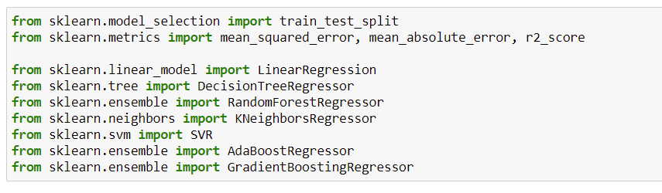
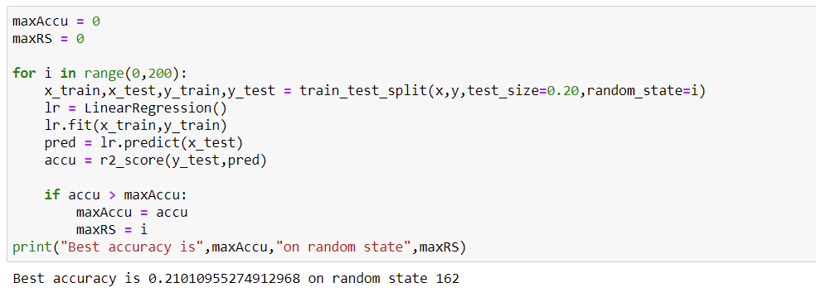

Slide 12
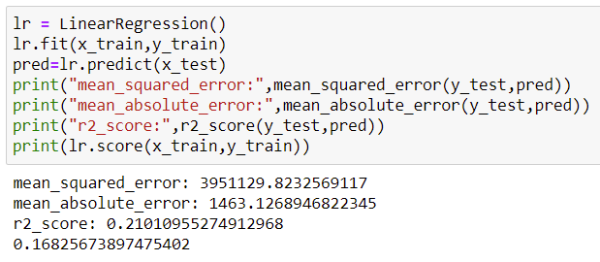
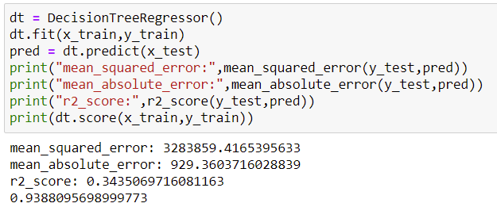
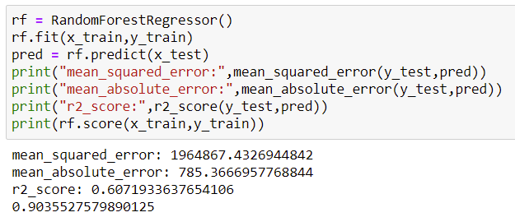
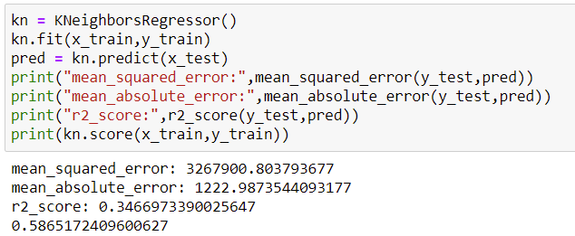
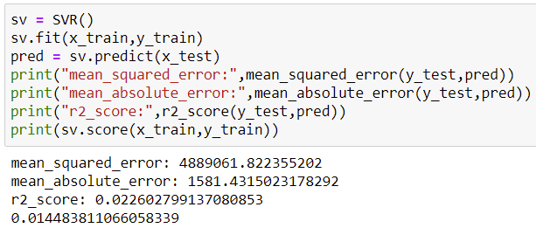
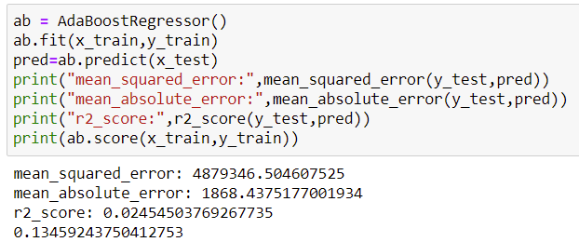

Slide 13
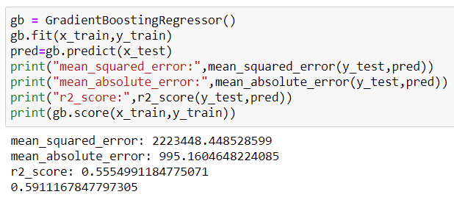
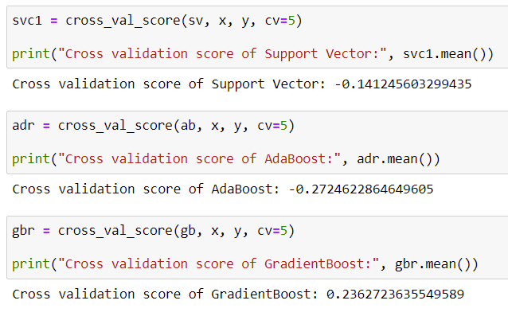
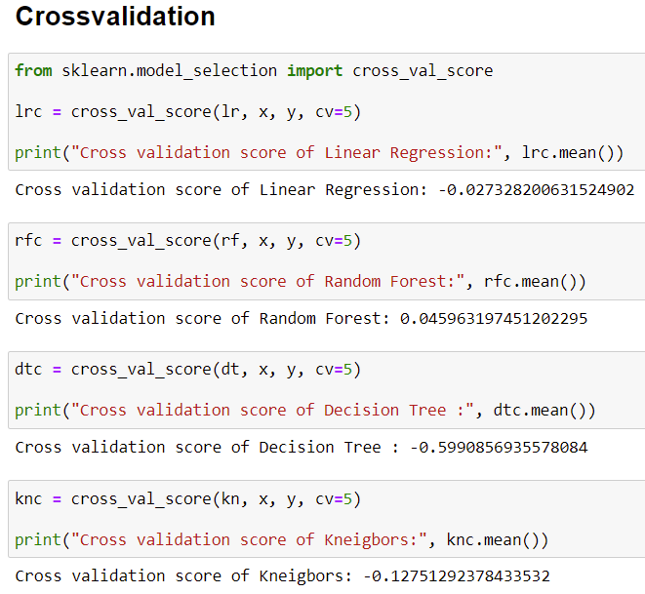

Slide 14
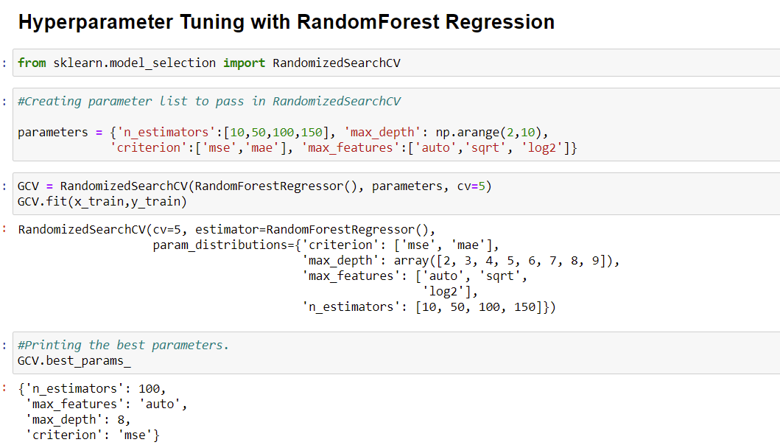

Slide 15
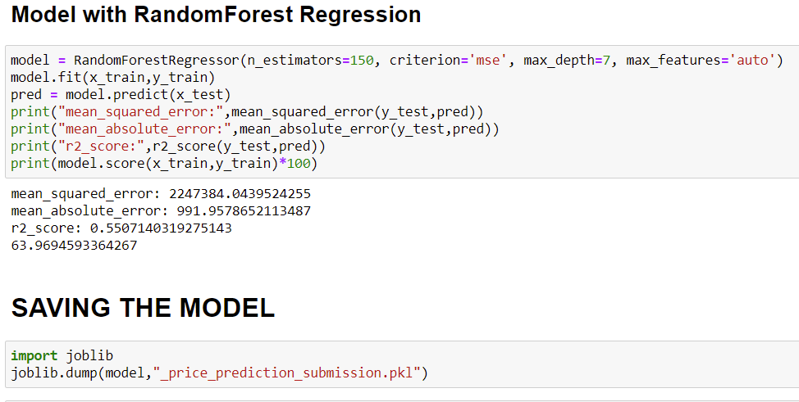

Slide 16
CONCLUSION
Key Findings and Conclusions of the Study:
If the departure date is far and has more stop in route with long hour flight duration the price would be comparatively low.
Indigo would be the most preferred Airline. Majority of flights take off from Kolkatta and Chennai. Maximum flights land in New Delhi and Patna.

Slide 17
THANKS TO:
Mentor/SME @ FlipRobo Technologies
DataScientists and mentors at DataTrained Institute.
ALSO TOOK HELP FROM:
Kaggle.
Stack Over Flow.
Towards Data Science.
PRESENTED BY:
Pawar Vinay Prasad (Data science Intern @ FlipRobo Technologies).

